Slide 1
Data science with R
FELIX OWUSU-ANSAH

Slide 2
ALGERIA FOREST FIRES PROJECT
About the Project
Predicting either fires occurring or fires not occurring in the forest in Algeria
The forest fire prediction project involves various data features and FWI (Fire Weather Index) components:
Outcome
Fire: Indicates the presence of a forest fire.
No Fire: Indicates the absence of a forest fire. These features and indices help in building predictive models to assess and forecast the likelihood of forest fires. The models can analyze patterns and correlations within the data to predict fire occurrence, aiding in effective fire management and prevention strategies.
Data Features | FWI Components
Month | Fine Fuel Moisture Code (FFMC)
Day | Duff Moisture Code (DMC)
Temperature | Drought Code (DC)
RH (Relative Humidity) | Initial Spread Index (ISI)
Ws (Wind Speed) | Rain

Slide 3
DATA PREPARATION, PRE-PROCESSING, AND FEATURE SELECTION
Missing item : 0
Duplicates: 0
Relevant feature targeted :
month, FFMC, DMC, DC, ISI, Temperature, RH, wind, rain, outcome

Slide 4
The models implemented in the project
Logistic Regression
Decision Tree regression
Random Forest Regression

Slide 5
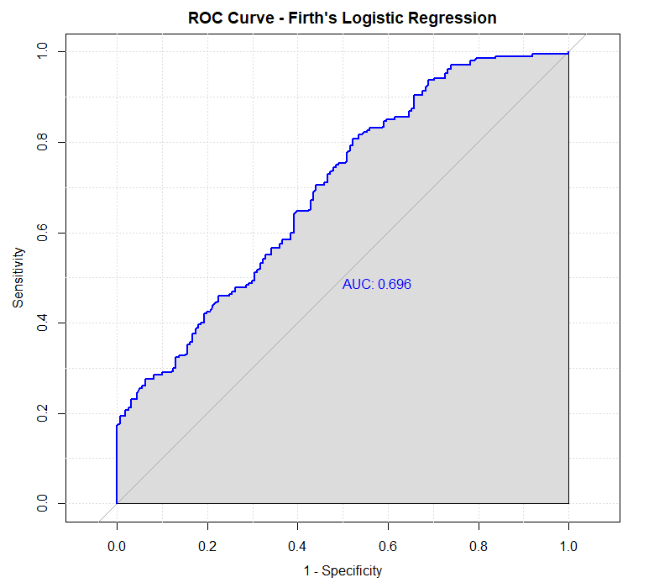
LOGISTICS REGRESSION
Conf. Matrix | POSITIVE | NEGATIVE
POSITIVE | 71 | 36
NEGATIVE | 90 | 171
Performance metrics result
Accuracy: 65.8%
Sensitivity (Recall): 82.6%
Specificity: 44.1%
ROC AUC: 0.696
OUTPUT:
The logistic regression model correctly predicts 66% of all cases. It catches 83% of actual fires but generates 90 false alarms. Best for overall accuracy when false alarms are acceptable.

Slide 6
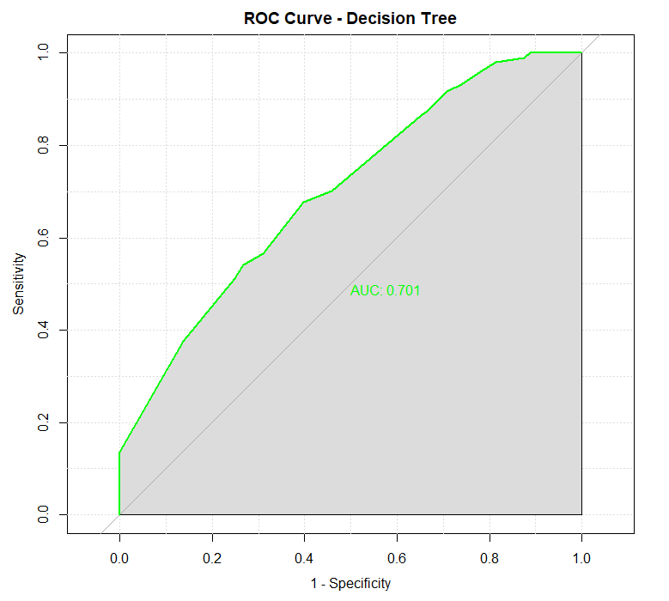
Decision tree regression
Conf. Matrix | POSITIVE | NEGATIVE
POSITIVE | 56 | 28
NEGATIVE | 105 | 179
Performance metrics result
Accuracy: 63.9%
Sensitivity (Recall): 86.5%
Specificity: 34.8%
ROC AUC: 0.701
OUTPUT: The decision tree catches the most fires (86.5%) but has the highest false alarm rate (105). It has the best AUC (0.701), making it the strongest model for distinguishing fire from no-fire conditions.

Slide 7
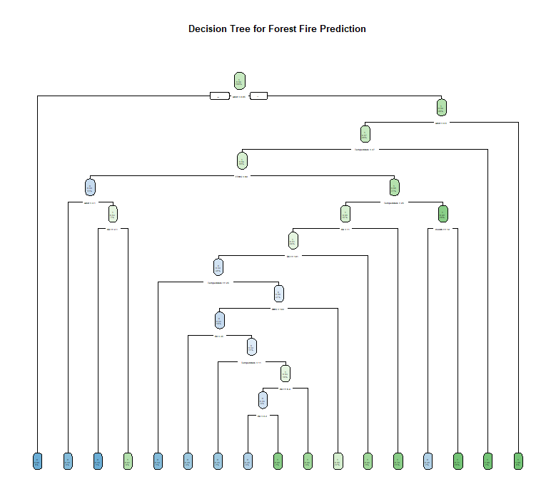
PREDICTING DECISION TREE OUTCOME

Slide 8
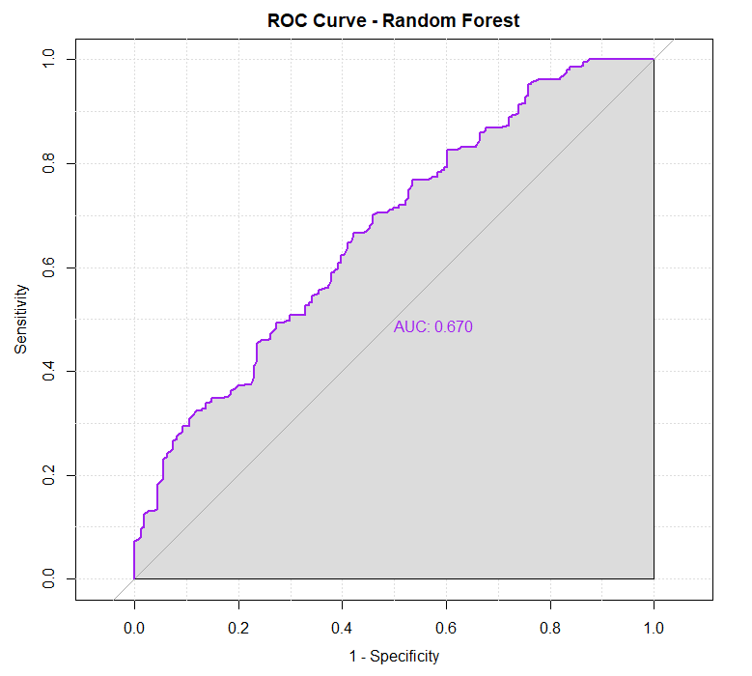
RANDOM FOREST regression
Conf. Matrix | POSITIVE | NEGATIVE
POSITIVE | 87 | 63
NEGATIVE | 74 | 144
Performance metrics result
Accuracy: 62.8%
Sensitivity (Recall): 69.6%
Specificity: 54%
ROC AUC: 0.670
OUTPUT:
The random forest has the lowest false alarm rate (74) and the highest specificity (54.0%). However, it catches the fewest fires (69.6%). Best when avoiding false alarms is the priority.

Slide 9
SUMMARY
Three predictive models were developed to forecast forest fires using weather and fuel moisture data. The Decision Tree model proved most effective, detecting 86.5% of all fires, the highest among all models tested.
KEY FINDINGS:
The most dangerous conditions for forest fires are:
• High wind speed (strongest predictor)
• Low fuel moisture (FFMC)
• High temperatures
CONCLUSION:
Adopting this predictive system can reduce fire damage by alerting authorities before conditions become dangerous, saving forests, property, and lives.

Slide 10
RECOMMENDATIONS TO THE COUNTRY
1. EARLY WARNING SYSTEM
Deploy the Decision Tree model as a national early warning system. It will alert authorities when fire risk is high.
2. RESOURCE ALLOCATION
Concentrate firefighting resources on days with:
Wind speeds above 5 km/h
Temperatures above 25°C
Low rainfall in the preceding week
3. PUBLIC AWARENESS
Issue public warnings when the model predicts high fire risk, especially during dry, windy, and hot conditions.
4. PREVENTIVE ACTIONS
Implement controlled burns and firebreaks before high-risk periods identified by the model.

